Slide 1
Overview slides
1 July 2025

Slide 2


Datasets
Hosted portals
114,614
54
Country Participants
66
Peer-review papers
using data (1 Apr 2025)
13,012
Organizational Participants
Average records
downloaded per month (2025)
42
273.0 billion
Species
occurrence records
Publishers
2,497
3,121,682,354
By the numbers | 1 July 2025
www.gbif.org

Slide 3
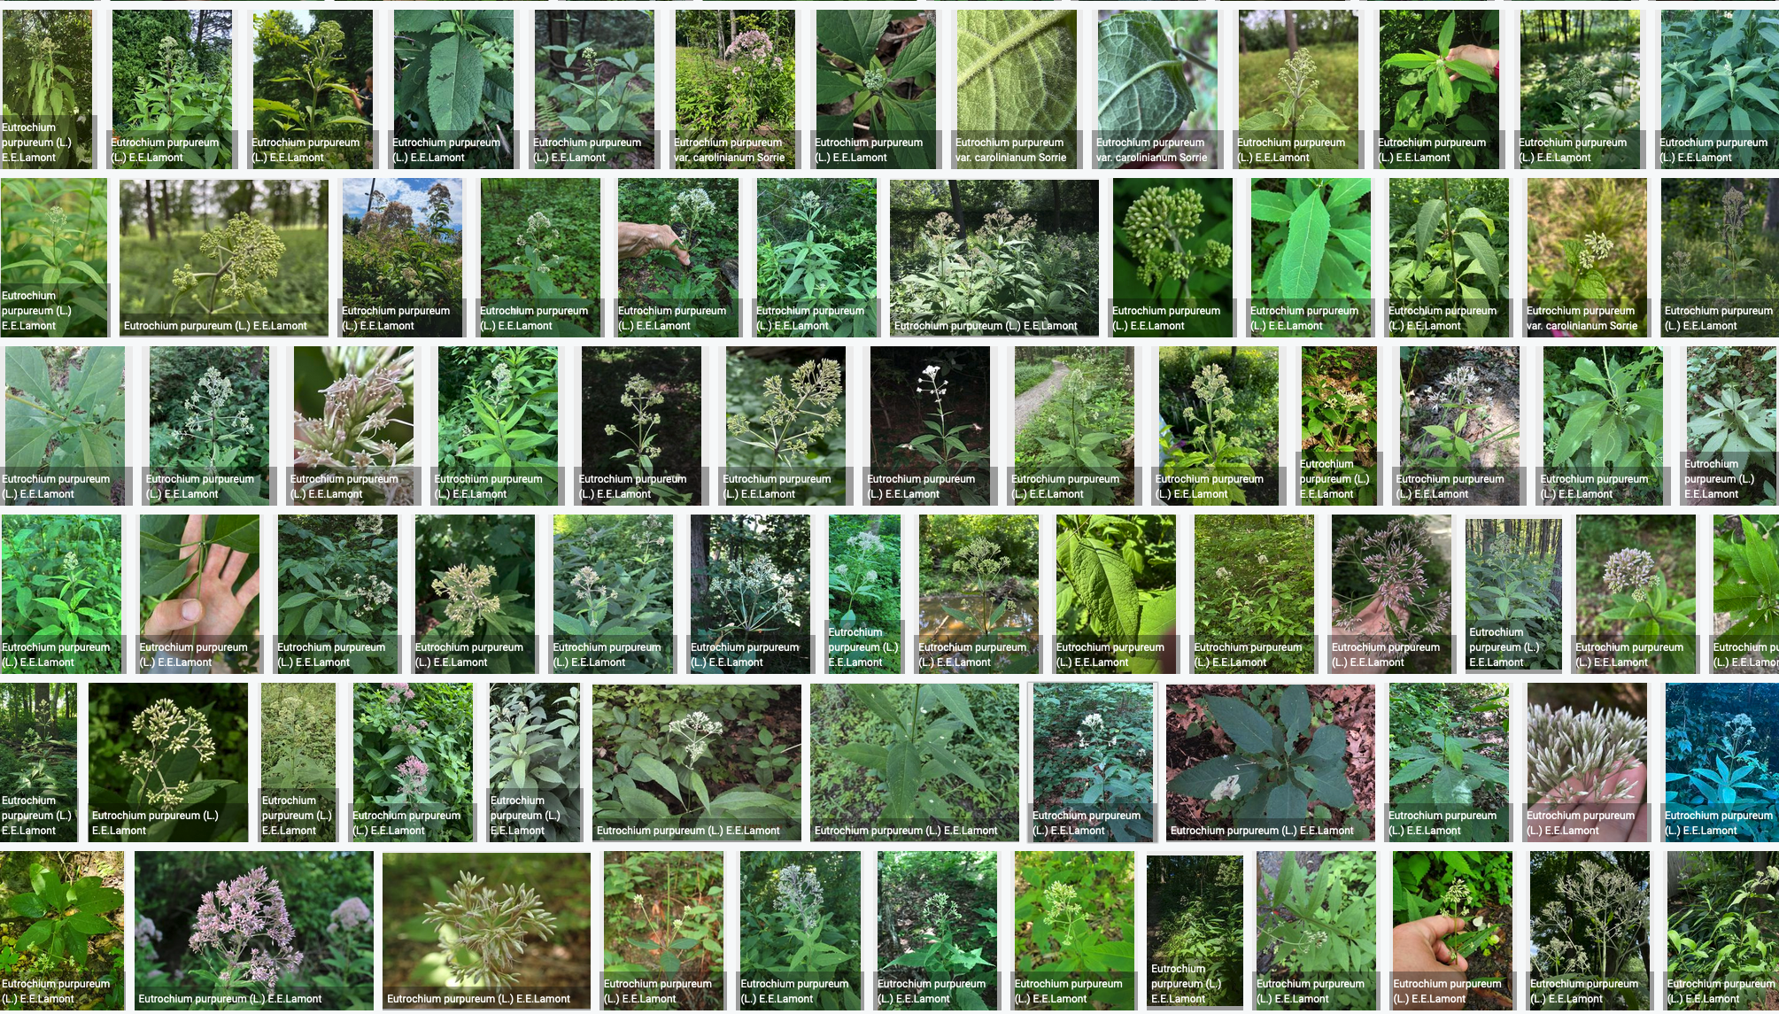
Species occurrence records with multimedia evidence
8 August 2025
244.8 million records with taxonomically identified images
164.4 million human observations
70.4 million specimens
7.1 million material samples
1.5 million fossil specimens
1,739,241 audio files
5,270 videos
https://www.gbif.org/occurrence/gallery

Slide 4
GBIF Participant countries
1 April 2025
Voting Participants
Associate Participants

Slide 5
GBIF network of data publishing institutions
25 August 2025
149
countries/areas with institutions
sharing data through GBIF
Number of active publishers by country or area

Slide 6
GBIF.org traffic by country: 2025
1 July 2025
Rank | Country/Territory | Visitors | Visits | Effective visits* | % Effective visits | 2024 rank | Pages / visit
1 | United States | 438,240 | 513,431 | 215,641 | 9.28 % | 1 | 4.13
2 | China | 681,012 | 1,519,664 | 212,753 | 9.15 % | 7 | 3.41
3 | Colombia | 200,079 | 253,724 | 121,788 | 5.24 % | 2 | 4.88
4 | Indonesia | 156,379 | 192,106 | 111,421 | 4.79 % | 3 | 6.02
5 | Spain | 169,904 | 213,102 | 110,813 | 4.77 % | 4 | 6.08
6 | France | 232,762 | 275,916 | 110,366 | 4.75 % | 5 | 4.31
7 | Brazil | 196,835 | 232,094 | 109,084 | 4.69 % | 8 | 4.79
8 | Germany | 176,298 | 216,238 | 99,551 | 4.28 % | 9 | 5.40
9 | Mexico | 156,317 | 185,509 | 70,760 | 3.67 % | 6 | 4.70
10 | India | 153,906 | 172.585 | 69,505 | 3.04 % | 10 | 4.28
 | TOTAL | 4,505,094 | 6,117,962 | 2,324,826 | 100.00% |  | 4.66

Slide 7
Occurrences published by country: 2025
1 July 2025
Rank | Country/Territory | 2025 | 2024 total | 2024 rank
1 | United Kingdom | 23,250,808 | 12,938,043 | 7
2 | United States | 17,179,390 | 158,323,610 | 1
3 | Netherlands | 11,851,170 | 25,251,786 | 4
4 | Sweden | 9,854,260 | 25,696,307 | 3
5 | France | 9,682,220 | 43,910,491 | 2
6 | Canada | 6,273,789 | 22,530,128 | 5
7 | Denmark | 4,288,605 | 3,440,172 | 18
8 | Switzerland Germany | 2,812,641 | 3,062,243 | 21
9 | Norway | 2,515,294 | 4,061,537 | 17
10 | Belgium | 2,398,102 | 5,800,027 | 13
OTHER COUNTRIES + AREAS | OTHER COUNTRIES + AREAS | 13,684,894 | 97,322,395
TOTAL |  | 103,791,173 | 428,451,251

Slide 8
Data download requests by country: 2025
1 July 2025
Rank | Country |  | 2025 | 2024 total | 2024 rank
1 | China | 41,998 |  | 63,485 | 1
2 | United States | 35,340 |  | 41,921 | 2
3 | Mexico | 19,086 |  | 29,712 | 3
4 | Brazil | 12,412 |  | 21,641 | 4
5 | Colombia | 11,592 |  | 21,274 | 5
6 | United Kingdom | 10,458 |  | 13,502 | 7
7 | Spain | 9,408 |  | 14,704 | 6
8 | Germany | 6,794 |  | 8,558 | 10
9 | Canada | 6,013 |  | 8,946 | 8
10 | Italy | 5,300 |  | 5,344 | 13
OTHER COUNTRIES + AREAS | ALL OTHERS | 80,090 |  | 115,002
TOTAL |  | 238,491 |  | 347,717
165
countries, islands & territories where users have ≥5 requested downloads in 2025
Notes:
DOWNLOAD ADJUSTMENTS FOR USERS ≥500 DOWNLOADS FOR JAN-JUNE 2025: BR (1): 620; CN (5): 7989; CZ (1): 873; DE (1): 1232 ; DK (1): 526; ES (1): 2229; FR (1): 834; GB (5): 7705; HR (1): 1176; IT (1): 873; JP (1) 1315; KR (1): 2043; MX (1): 1414; NL (1): 693; US (7): 9491; ZA (1): 24987

Slide 9
Peer-reviewed publications using GBIF-mediated data
1 April 2025

Slide 10
Data use in peer-reviewed journals: 2025
1 April 2025
Peer-reviewed uses by country
Peer-reviewed uses by region
End of Year |  |  | 2025 total | 2024 total | 2024 rank
1 | China |  | 187 | 529 | 1
2 | United States |  | 134 | 486 | 2
3 | United Kingdom |  | 52 | 186 | 5
4 | Brazil |  | 48 | 238 | 3
5 | Germany |  | 43 | 186 | 6
6 | Spain |  | 37 | 171 | 7
6 | Mexico |  | 37 | 186 | 4
8 | Australia |  | 31 | 104 | 10
9 | Italy |  | 28 | 107 | 8
10 | India |  | 27 | 78 | 12

Slide 11


Suggestions reviewed
Institutions
8,787
2,766
vv
Countries
Collections
125
10,158
Country editors
Digitized specimens
68
248,566,791
GRSciColl by the numbers | 25 August 2025
scientific-collections.gbif.org
Notes:
Our community of editors is doing a huge work to update GRSciColl. In 2024 alone, more than 1600 entries were added to GRSciColl. At the core of the GRSciColl work are our Nodes and the GBIF Regional support teams which have been working on reaching out to institutions in GRSciColl as an entry point to sharing GBIF data.

Slide 12




Hosted portals update
13
GBIF national Participants and regions
8
Institutional
54
Hosted portals in production
6
27
Networks/thematic networks
Scientific journal

Slide 14
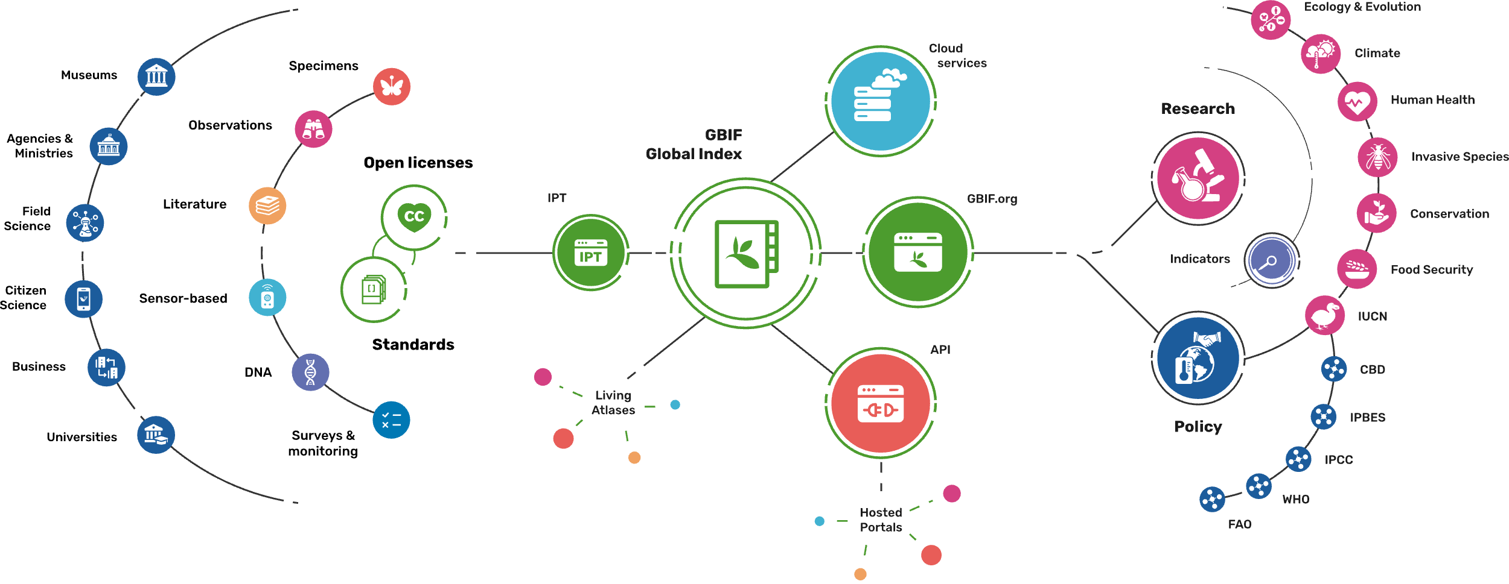
Providing biodiversity evidence for research and policy

Slide 15
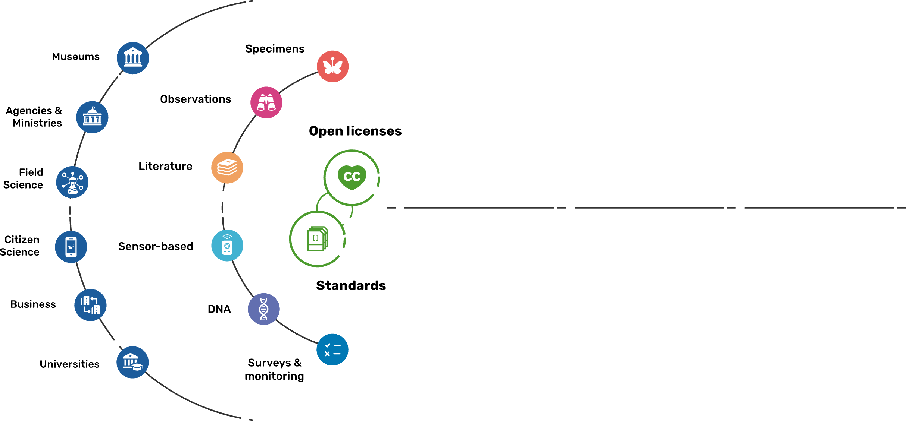
Sources of biodiversity evidence
Create
Combine sources of evidence

Slide 16
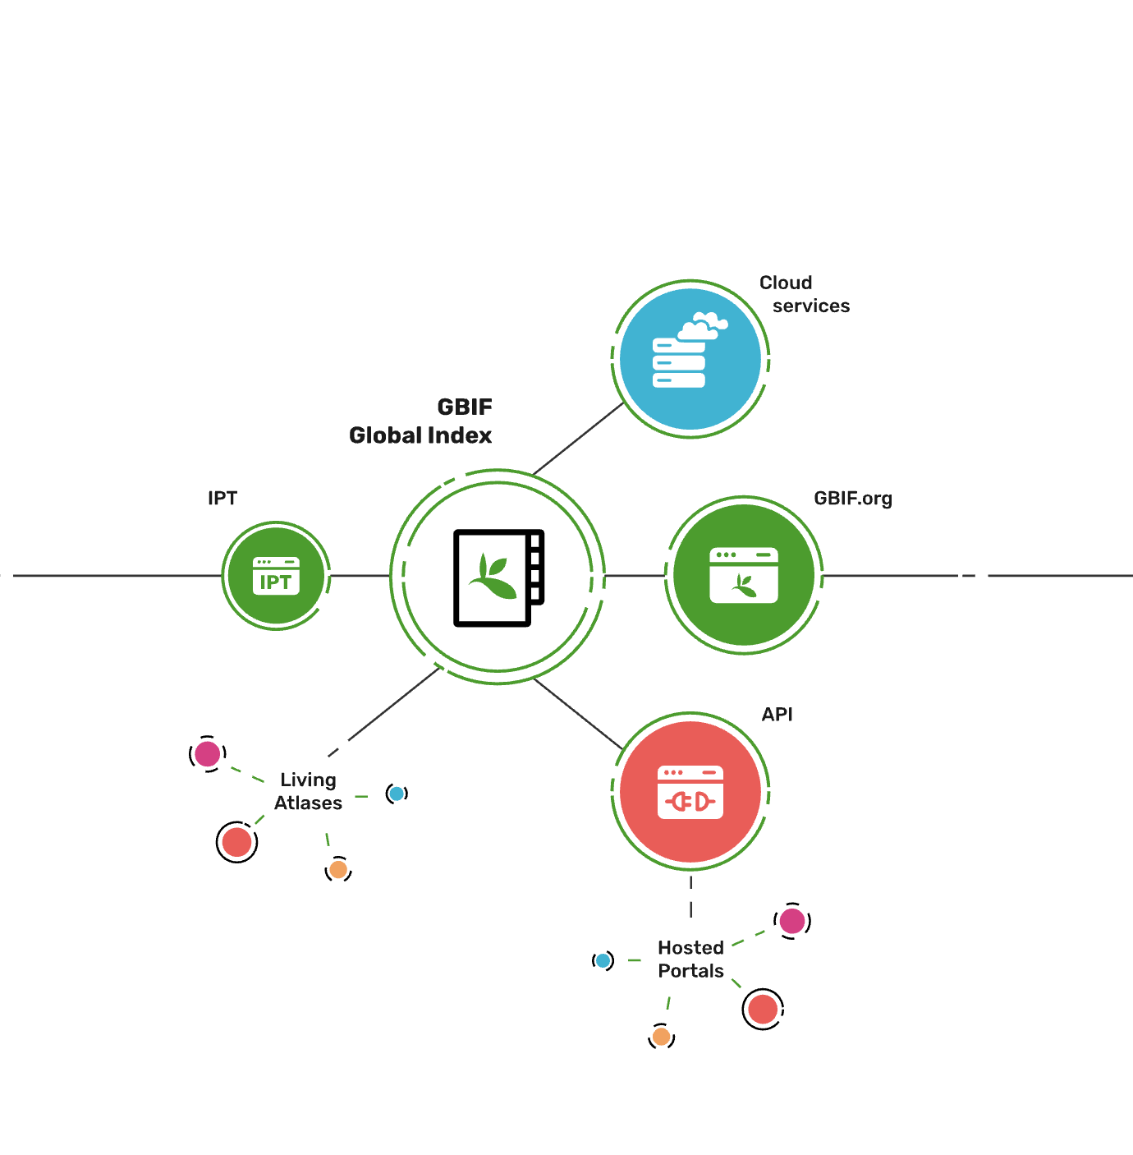
Access to biodiversity evidence
Share
FAIR and open access

Slide 17
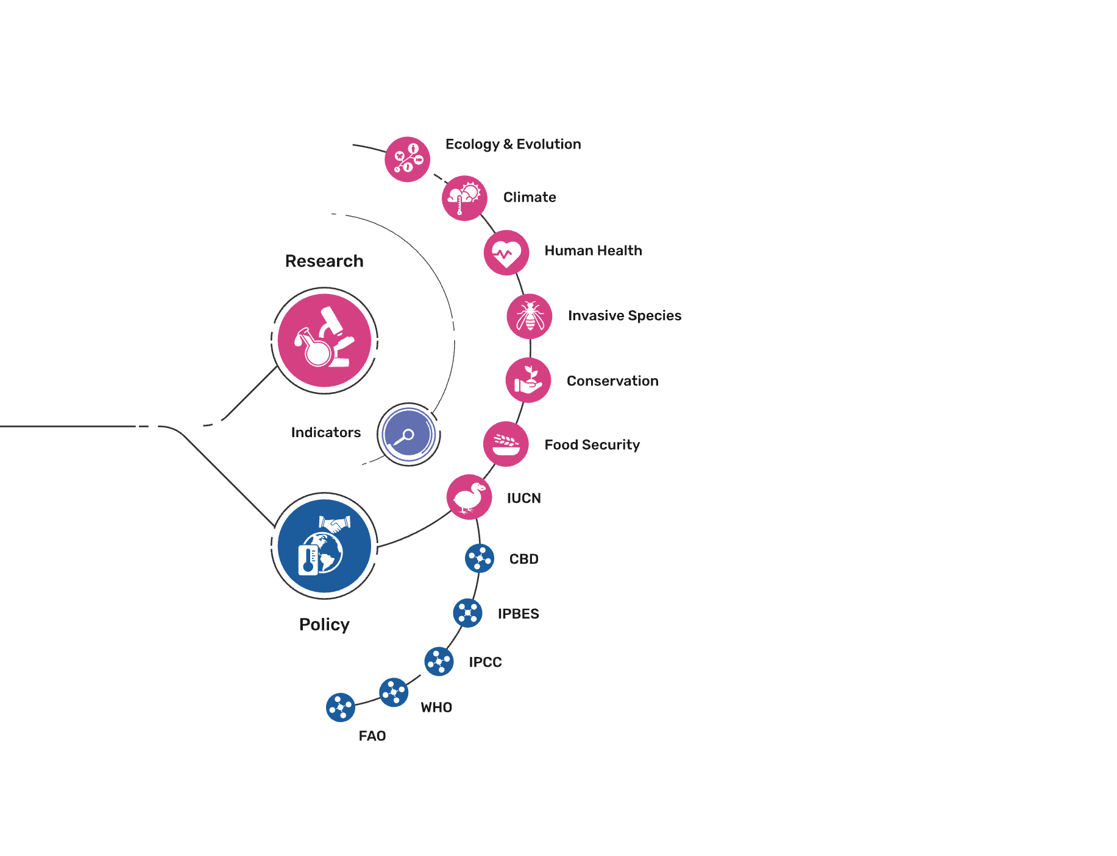
Uses of biodiversity evidence
Transform
Apply and use data

